Slide 1



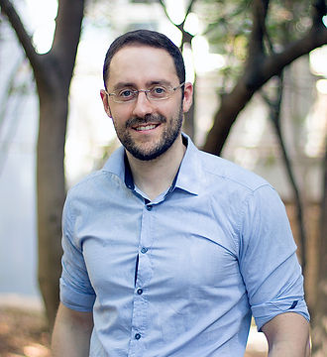
Hearing the Room Through the Shape of the Drum
Modal-Guided Sound Recovery from Multi-Point Surface Vibrations
Shai Bagon Matan Kichler Mark Sheinin
Weizmann Institute of Science

Slide 2

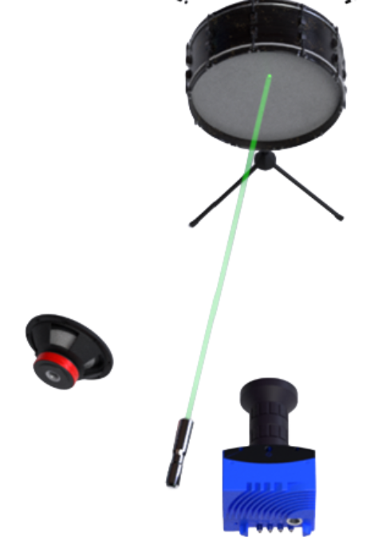
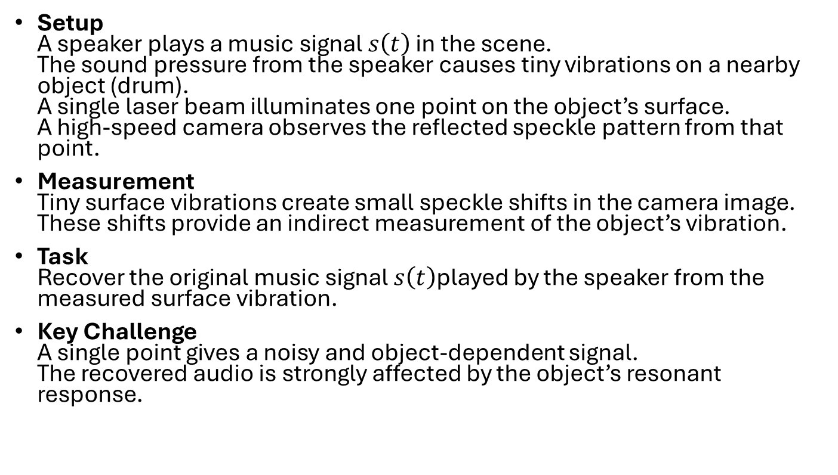
Setup and Task
Setup A speaker plays a music signal $s\left(t\right)$ in the scene. The sound pressure from the speaker causes tiny vibrations on a nearby object (drum). A single laser beam illuminates one point on the object’s surface. A high-speed camera observes the reflected speckle pattern from that point.
Measurement Tiny surface vibrations create small speckle shifts in the camera image. These shifts provide an indirect measurement of the object’s vibration.
Task Recover the original music signal $s\left(t\right)$played by the speaker from the measured surface vibration.
Key Challenge A single point gives a noisy and object-dependent signal. The recovered audio is strongly affected by the object’s resonant response.

Slide 3
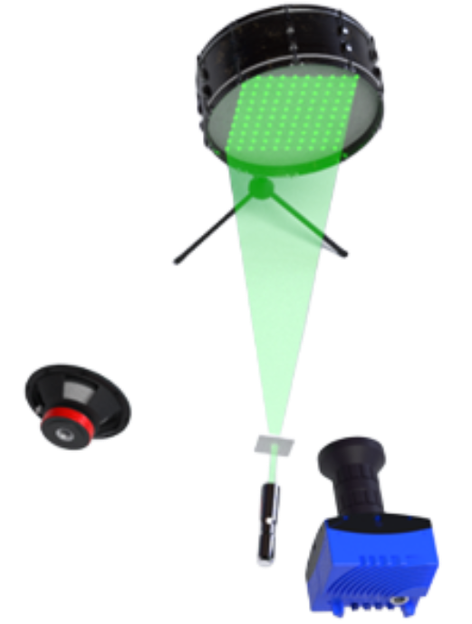
From One Laser Point to a Grid
Setup A laser splitter turns the single laser beam into a grid of illumination points on the object surface.
Opportunity The object now acts like a distributed visual microphone. Different grid points capture different parts of the object’s vibration response to the same music signal.
Key Question How can we combine the grid measurements in a physically meaningful way to improve recovery of the speaker’s music signal?

Slide 4
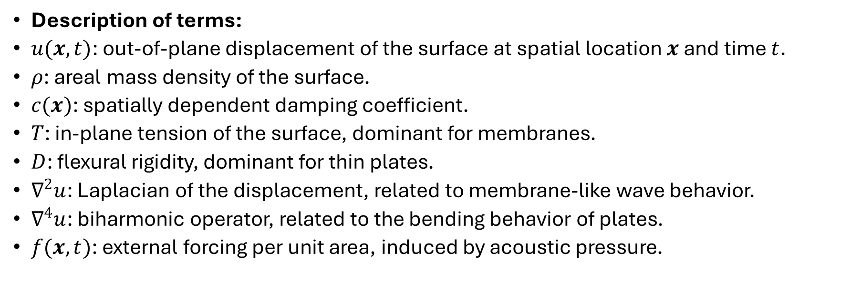

Surface Vibration Model
General wave equation:
$$ρ\frac{∂^{2}u}{∂t^{2}}+c(x)\frac{∂u}{∂t}−T∇^{2}u+D∇^{4}u=f(x,t)$$
Description of terms:
$u(x,t)$: out-of-plane displacement of the surface at spatial location $x$ and time $t$.
$ρ$: areal mass density of the surface.
$c(x)$: spatially dependent damping coefficient.
$T$: in-plane tension of the surface, dominant for membranes.
$D$: flexural rigidity, dominant for thin plates.
$∇^{2}u$: Laplacian of the displacement, related to membrane-like wave behavior.
$∇^{4}u$: biharmonic operator, related to the bending behavior of plates.
$f(x,t)$: external forcing per unit area, induced by acoustic pressure.

Slide 5
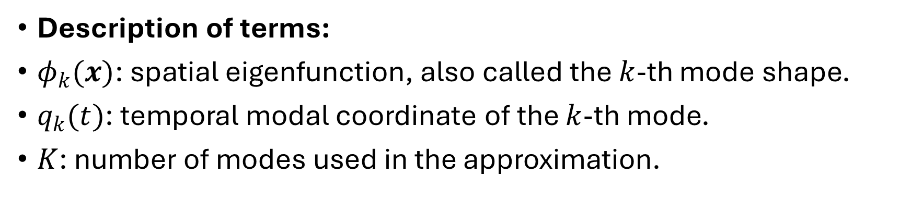

Modal Decomposition
Expansion into vibration modes
$$u(x,t)=\sum_{k=1}^{K}{φ_{k}}(x)q_{k}(t)$$
Description of terms:
$φ_{k}(x)$: spatial eigenfunction, also called the $k$-th mode shape.
$q_{k}(t)$: temporal modal coordinate of the $k$-th mode.
$K$: number of modes used in the approximation.

Slide 6
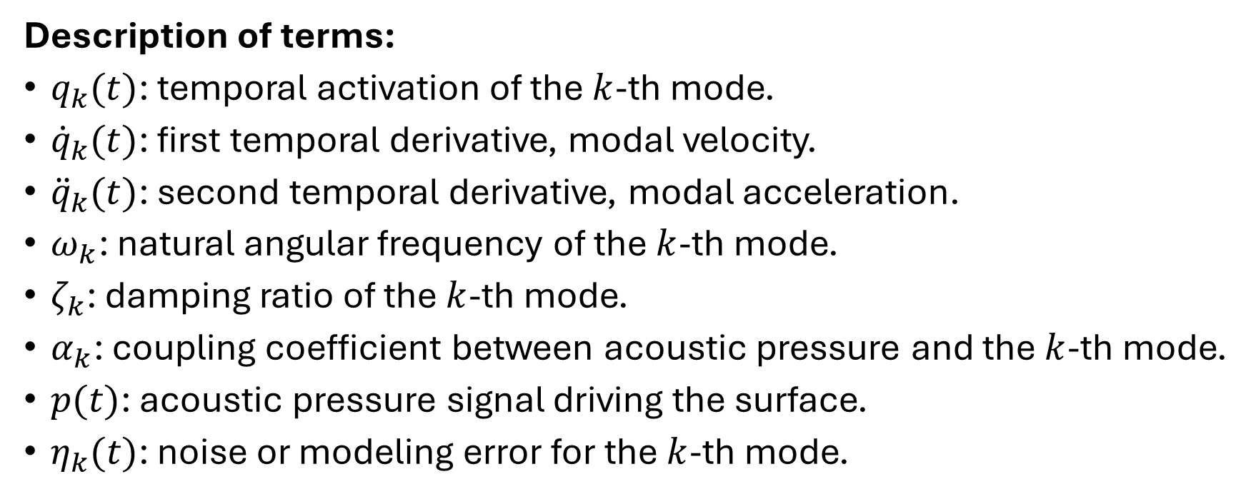

Second-order modal oscillator:
Modal Decomposition
$${\ddot{q}}_{k}(t)+2ζ_{k}ω_{k}{\dot{q}}_{k}(t)+ω_{k}^{2}q_{k}(t)=α_{k}p(t)+η_{k}(t)$$
Description of terms:
$q_{k}(t)$: temporal activation of the $k$-th mode.
${\dot{q}}_{k}(t)$: first temporal derivative, modal velocity.
${\ddot{q}}_{k}(t)$: second temporal derivative, modal acceleration.
$ω_{k}$: natural angular frequency of the $k$-th mode.
$ζ_{k}$: damping ratio of the $k$-th mode.
$α_{k}$: coupling coefficient between acoustic pressure and the $k$-th mode.
$p(t)$: acoustic pressure signal driving the surface.
$η_{k}(t)$: noise or modeling error for the $k$-th mode.

Slide 7
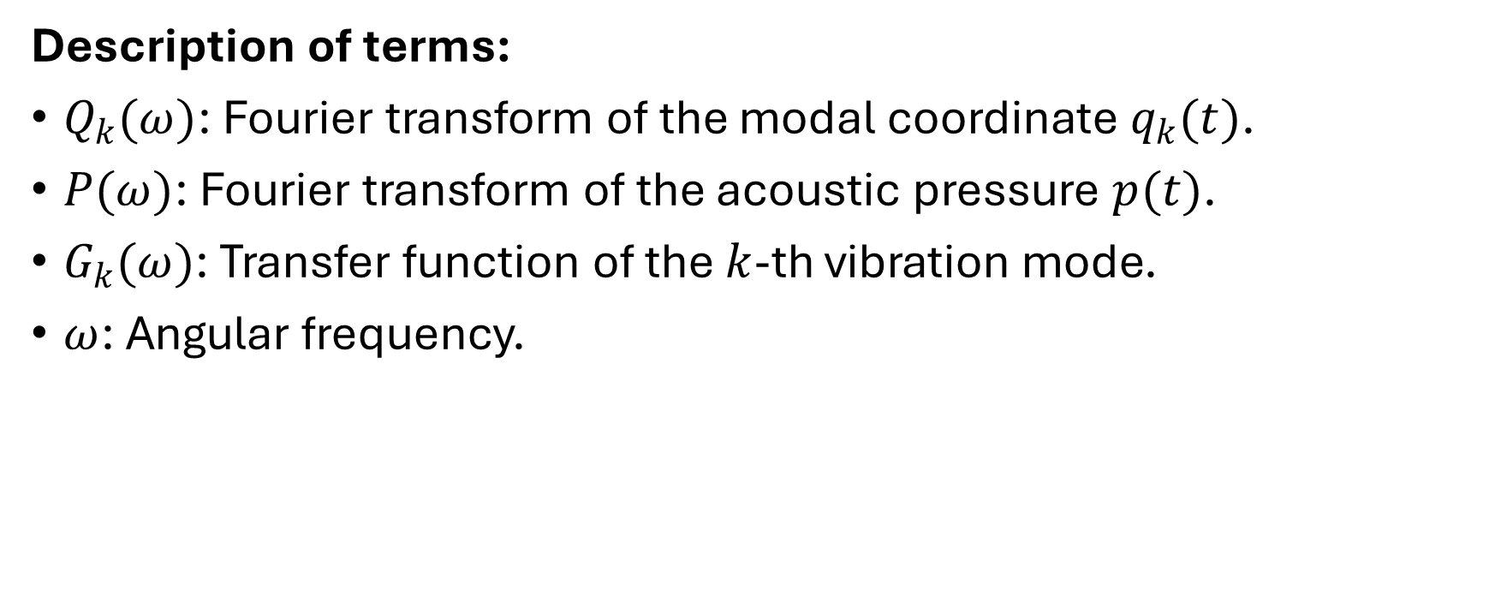
Modal response in the frequency domain:
Frequency-Domain Modal Transfer Function
$$Q_{k}(ω)=G_{k}(ω)P(ω)$$
Description of terms:
$Q_{k}(ω)$: Fourier transform of the modal coordinate $q_{k}(t)$.
$P(ω)$: Fourier transform of the acoustic pressure $p(t)$.
$G_{k}(ω)$: Transfer function of the $k$-th vibration mode.
$ω$: Angular frequency.

Slide 8
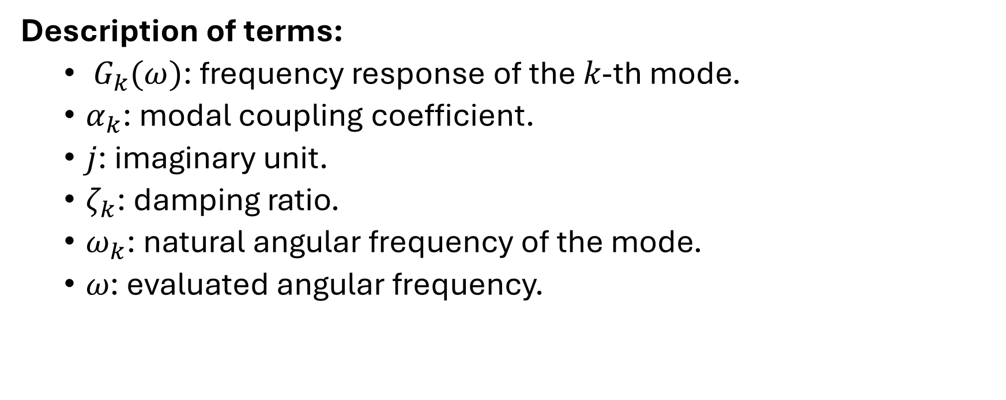
Second-order oscillator transfer function:
$$G_{k}(ω)=\frac{α_{k}}{−ω^{2}+j2ζ_{k}ω_{k}ω+ω_{k}^{2}}$$
Description of terms:
$G_{k}(ω)\text{: }\text{frequency} \text{response} \text{of} \text{the} k\text{−}\text{th} \text{mode}\text{.}$
$α_{k}\text{: }\text{modal} \text{coupling} \text{coefficient}\text{.}$
$j\text{: }\text{imaginary} \text{unit}\text{.}$
$ζ_{k}\text{: }\text{damping} \text{ratio}\text{.}$
$ω_{k}\text{: }\text{natural} \text{angular} \text{frequency} \text{of} \text{the} \text{mode}\text{.}$
$ω\text{: }\text{evaluated} \text{angular} \text{frequency}\text{.}$

Slide 9
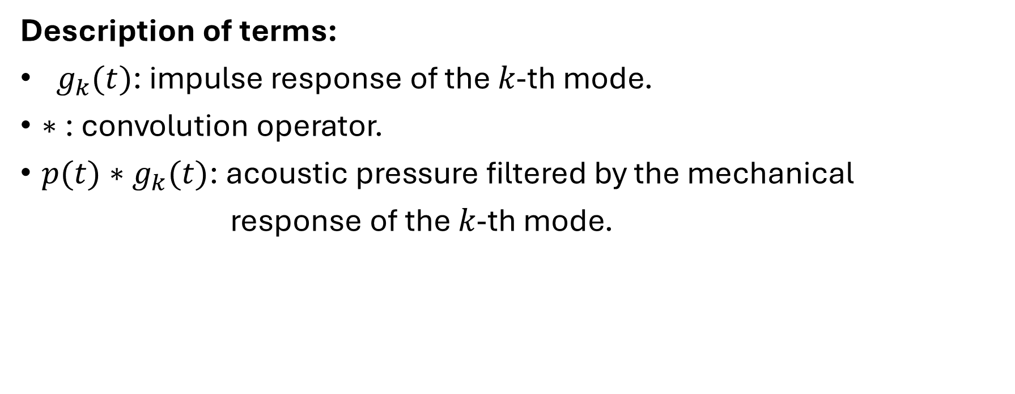

Surface Displacement as a Modal Convolution
$$u(x,t)=\sum_{k=1}^{K}{φ_{k}}(x)\left(p(t)∗g_{k}(t)\right)$$
Description of terms:
$g_{k}(t)\text{: }\text{impulse} \text{response} \text{of} \text{the} k\text{−}\text{th} \text{mode}\text{.}$
$∗\text{: }\text{convolution} \text{operator}\text{.}$
$p(t)∗g_{k}(t)\text{: }\text{acoustic} \text{pressure} \text{filtered} \text{by} \text{the} \text{mechanical}$
$\text{response} \text{of} \text{the} k\text{−}\text{th} \text{mode}\text{.}$

Slide 10
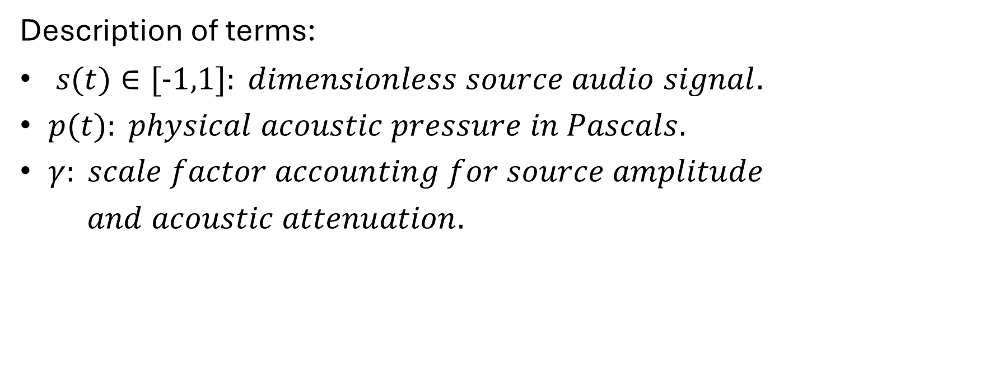
Sound Pressure and Source Signal
$$p(t)=γs(t)$$
Description of terms:
$and acoustic attenuation.$

Slide 11
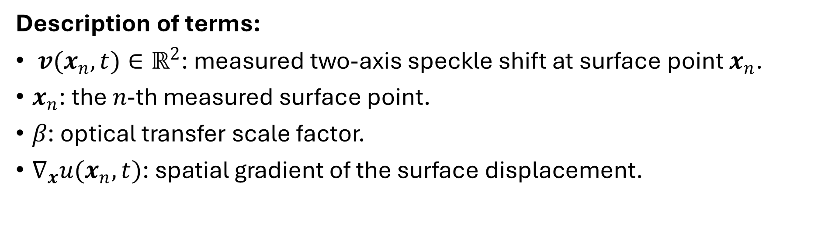
Speckle-Based Vibration Measurements
Speckle shifts as surface gradients
$$v(x_{n},t)=β∇_{x}u(x_{n},t)$$
Description of terms:
$v(x_{n},t)∈ℝ^{2}\text{: }\text{measured} \text{two}\text{−}\text{axis} \text{speckle} \text{shift} \text{at} \text{surface} \text{point} x_{n}\text{.}$
$x_{n}\text{: }\text{the} n\text{−}\text{th} \text{measured} \text{surface} \text{point}\text{.}$
$β\text{: }\text{optical} \text{transfer} \text{scale} \text{factor}\text{.}$
$∇_{x}u(x_{n},t)\text{: }\text{spatial} \text{gradient} \text{of} \text{the} \text{surface} \text{displacement}\text{.}$

Slide 12
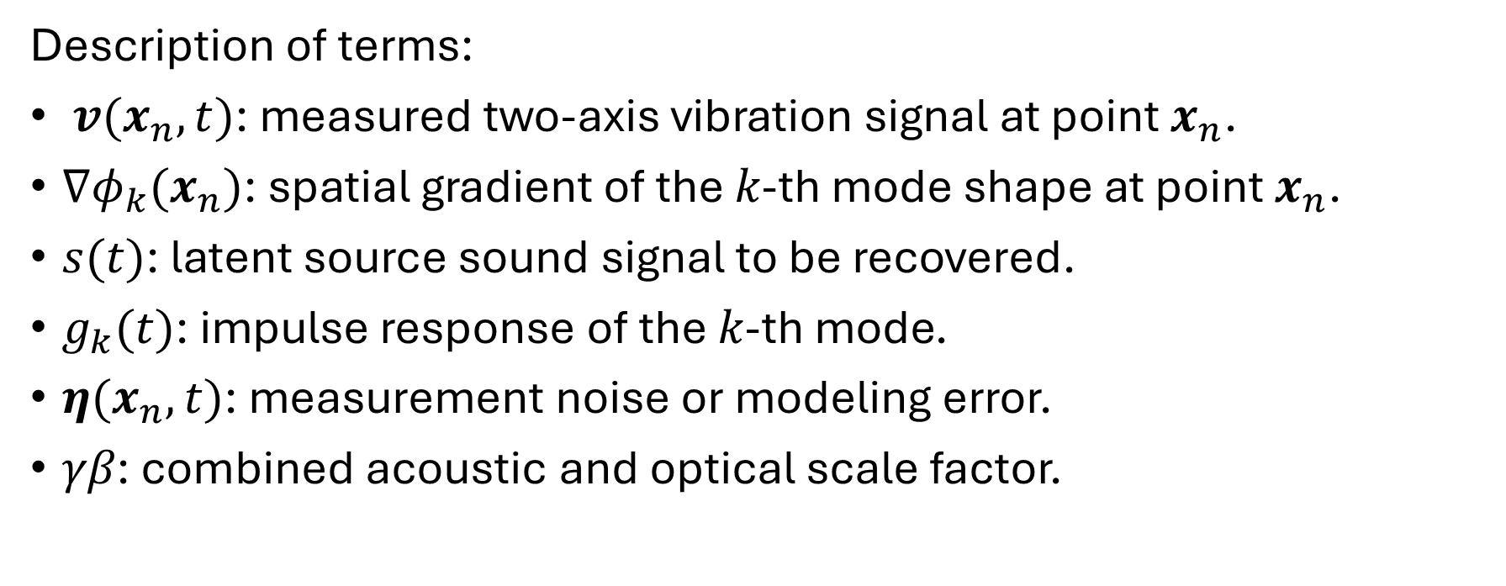

Forward model from sound to measured speckle shifts
$$v(x_{n},t)≈γβ\sum_{k=1}^{K}{∇}φ_{k}(x_{n})\left(s(t)∗g_{k}(t)\right)+η(x_{n},t)$$
Description of terms:
$v(x_{n},t)\text{: }\text{measured} \text{two}\text{−}\text{axis} \text{vibration} \text{signal} \text{at} \text{point} x_{n}\text{.}$
$∇φ_{k}(x_{n})\text{: }\text{spatial} \text{gradient} \text{of} \text{the} k\text{−}\text{th} \text{mode} \text{shape} \text{at} \text{point} x_{n}\text{.}$
$s(t)\text{: }\text{latent} \text{source} \text{sound} \text{signal} \text{to} \text{be} \text{recovered}\text{.}$
$g_{k}(t)\text{: }\text{impulse} \text{response} \text{of} \text{the} k\text{−}\text{th} \text{mode}\text{.}$
$η(x_{n},t)\text{: }\text{measurement} \text{noise} \text{or} \text{modeling} \text{error}\text{.}$
$γβ\text{: }\text{combined} \text{acoustic} \text{and} \text{optical} \text{scale} \text{factor}\text{.}$

Slide 13
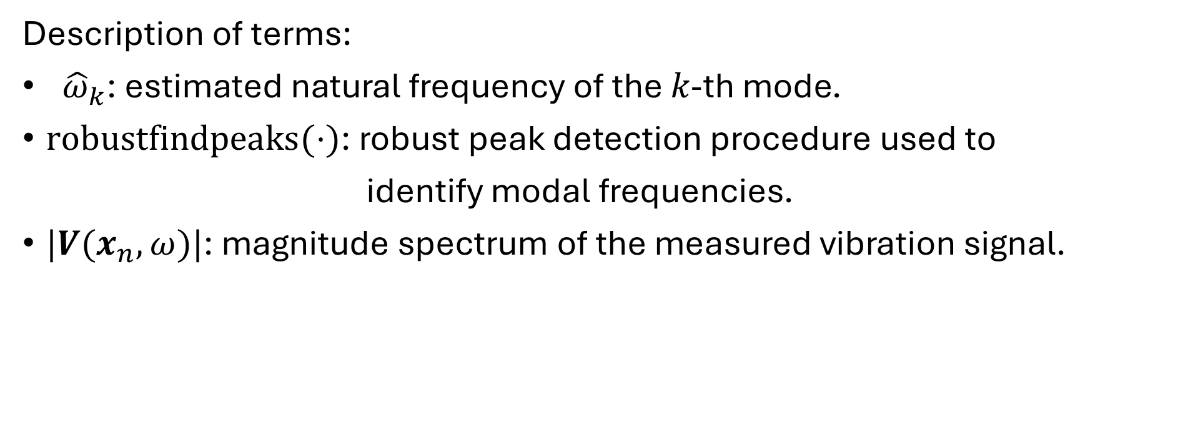
Mode Frequency Estimation
$${\left\{{\hat{ω}}_{k}\right\}}_{k=1}^{K}←robust_find_peaks\left(\left|V(x_{n},ω)\right|\right)$$
Description of terms:
${\hat{ω}}_{k}\text{: }\text{estimated} \text{natural} \text{frequency} \text{of} \text{the} k\text{−}\text{th} \text{mode}\text{.}$
$robustfindpeaks(⋅)\text{: }\text{robust} \text{peak} \text{detection} \text{procedure} \text{used} \text{to}$
$\text{identify} \text{modal} \text{frequencies}\text{.}$
$|V(x_{n},ω)|\text{: }\text{magnitude} \text{spectrum} \text{of} \text{the} \text{measured} \text{vibration} \text{signal}\text{.}$

Slide 14
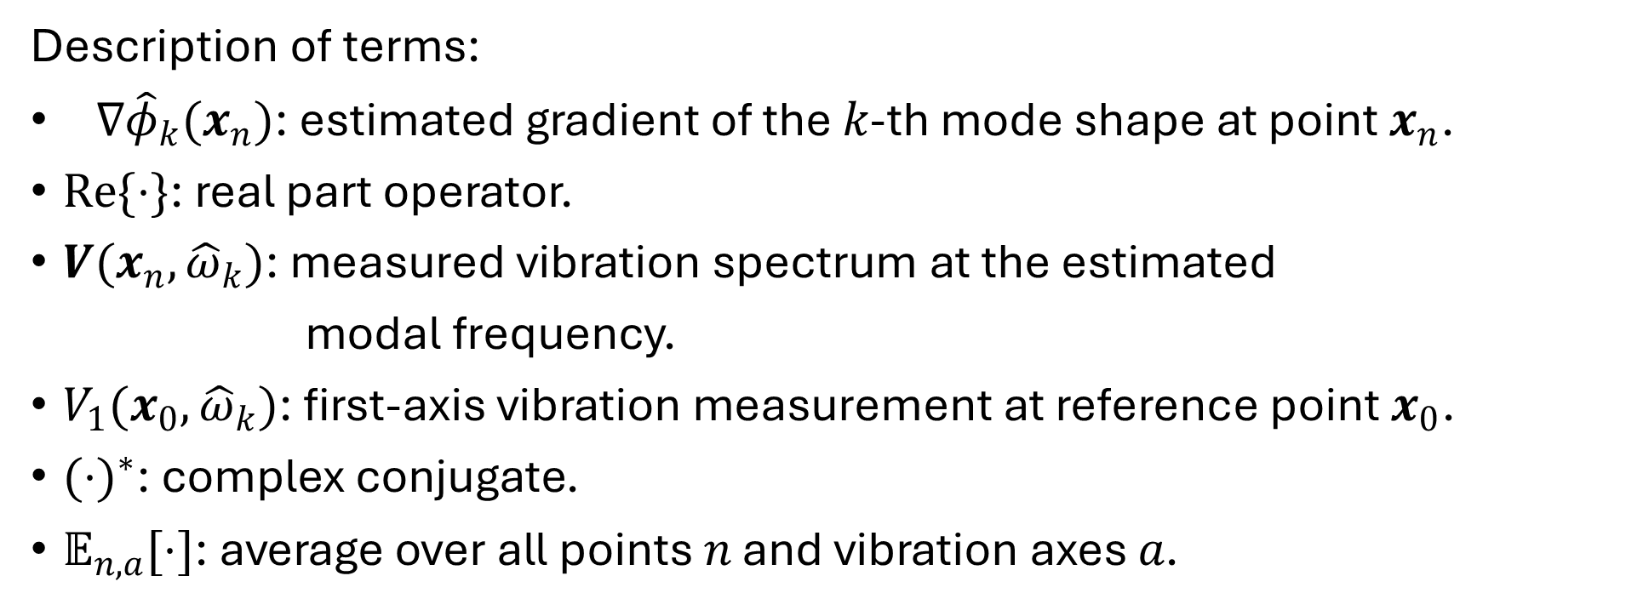

Mode Shape Gradient Estimation
$$∇{\hat{φ}}_{k}(x_{n})=Re\left\{\frac{V(x_{n},{\hat{ω}}_{k})⋅V_{1}(x_{0},{\hat{ω}}_{k})^{∗}}{𝔼_{n,a}\left[\left|V(x_{n},{\hat{ω}}_{k})\right|\right]⋅\left|V_{1}(x_{0},{\hat{ω}}_{k})\right|}\right\}$$
Description of terms:
$∇{\hat{φ}}_{k}(x_{n})\text{: }\text{estimated} \text{gradient} \text{of} \text{the} k\text{−}\text{th} \text{mode} \text{shape} \text{at} \text{point} x_{n}\text{.}$
$Re\{⋅\}\text{: }\text{real} \text{part} \text{operator}\text{.}$
$V(x_{n},{\hat{ω}}_{k})\text{: }\text{measured} \text{vibration} \text{spectrum} \text{at} \text{the} \text{estimated}$
$\text{modal} \text{frequency}\text{.}$
$V_{1}(x_{0},{\hat{ω}}_{k})\text{: }\text{first}\text{−}\text{axis} \text{vibration} \text{measurement} \text{at} \text{reference} \text{point} x_{0}\text{.}$
$(⋅)^{∗}\text{: }\text{complex} \text{conjugate}\text{.}$
$𝔼_{n,a}[⋅]\text{: }\text{average} \text{over} \text{all} \text{points} n \text{and} \text{vibration} \text{axes} a\text{.}$

Slide 15
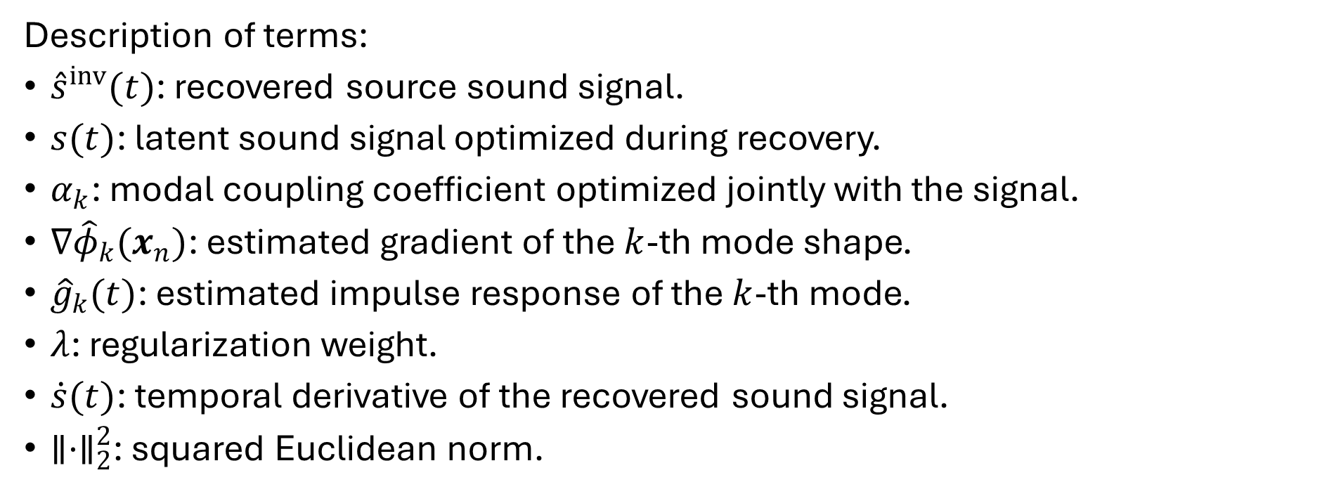
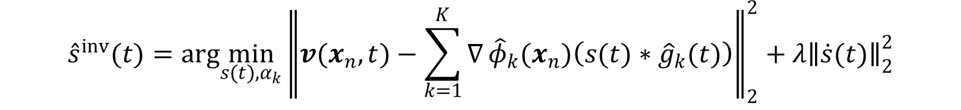
Sound Recovery Optimization
$${\hat{s}}^{inv}(t)=arg\min_{s(t),α_{k}}{∥v(x_{n},t)−\sum_{k=1}^{K}{∇}{\hat{φ}}_{k}(x_{n})\left(s(t)∗{\hat{g}}_{k}(t)\right)∥}_{2}^{2}+λ{∥\dot{s}(t)∥}_{2}^{2}$$
Description of terms:
${\hat{s}}^{inv}(t)$: recovered source sound signal.
$s(t)$: latent sound signal optimized during recovery.
$α_{k}$: modal coupling coefficient optimized jointly with the signal.
$∇{\hat{φ}}_{k}(x_{n})$: estimated gradient of the $k$-th mode shape.
${\hat{g}}_{k}(t)$: estimated impulse response of the $k$-th mode.
$λ$: regularization weight.
$\dot{s}(t)$: temporal derivative of the recovered sound signal.
$∥⋅∥_{2}^{2}$: squared Euclidean norm.

Slide 16
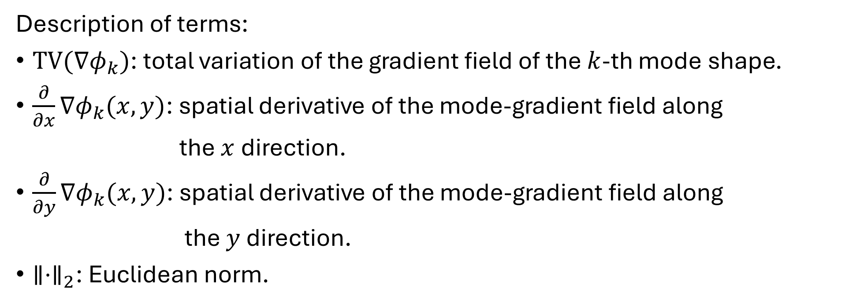

Total variation of a mode-shape gradient
$$TV\left(∇φ_{k}\right)=\sum_{x,y}^{​}{{∥\frac{∂}{∂x}∇φ_{k}(x,y)∥}_{2}}+{∥\frac{∂}{∂y}∇φ_{k}(x,y)∥}_{2}$$
Description of terms:
$TV(∇φ_{k})$: total variation of the gradient field of the $k$-th mode shape.
$\frac{∂}{∂x}∇φ_{k}(x,y)$: spatial derivative of the mode-gradient field along
the $x$direction.
$\frac{∂}{∂y}∇φ_{k}(x,y)$: spatial derivative of the mode-gradient field along
the $y$ direction.
$∥⋅∥_{2}$: Euclidean norm.

Slide 17
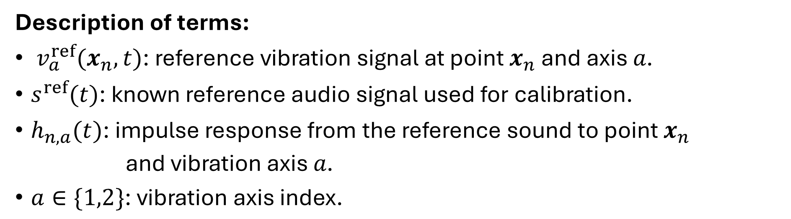
Calibration-Based Baseline
Reference convolution model
$$v_{a}^{ref}(x_{n},t)≈s^{ref}(t)∗h_{n,a}(t)$$
Description of terms:
$v_{a}^{ref}(x_{n},t)\text{: }\text{reference} \text{vibration} \text{signal} \text{at} \text{point} x_{n} \text{and} \text{axis} a\text{.}$
$s^{ref}(t)\text{: }\text{known} \text{reference} \text{audio} \text{signal} \text{used} \text{for} \text{calibration}\text{.}$
$h_{n,a}(t)\text{: }\text{impulse} \text{response} \text{from} \text{the} \text{reference} \text{sound} \text{to} \text{point} x_{n}$
$\text{and} \text{vibration} \text{axis} a\text{.}$
$a∈\{1,2\}\text{: }\text{vibration} \text{axis} \text{index}\text{.}$

Slide 18
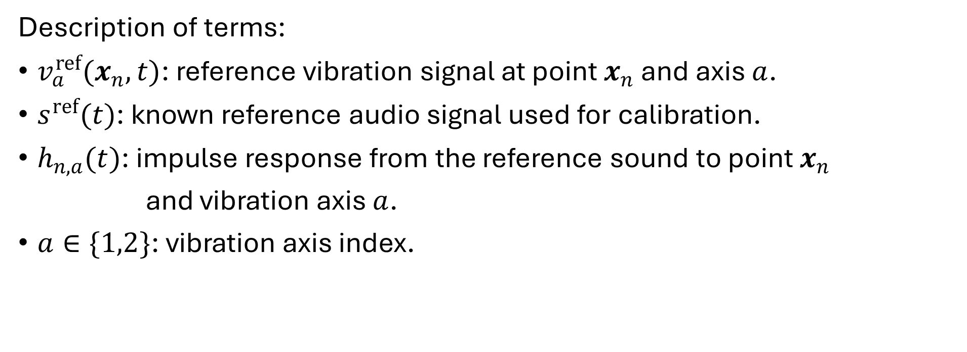
Reference convolution model
$$v_{a}^{ref}(x_{n},t)≈s^{ref}(t)∗h_{n,a}(t)$$
Description of terms:
$v_{a}^{ref}(x_{n},t)$: reference vibration signal at point $x_{n}$ and axis $a$.
$s^{ref}(t)$: known reference audio signal used for calibration.
$h_{n,a}(t)$: impulse response from the reference sound to point $x_{n}$
and vibration axis $a$.
$a∈\{1,2\}$: vibration axis index.

Slide 19

Inverse filter estimation
$${\hat{h}}_{n,a}^{−1}(t)=arg\min_{h(t)}{∥v_{a}^{ref}(x_{n},t)∗h(t)−s^{ref}(t)∥}_{2}^{2}$$
Description of terms:
${\hat{h}}_{n,a}^{−1}(t)$: estimated inverse filter for point $x_{n}$ and axis $a$.
$h(t)$: candidate inverse filter optimized by least squares.
$v_{a}^{ref}(x_{n},t)∗h(t)$: calibrated reconstruction of the reference signal.

Slide 20
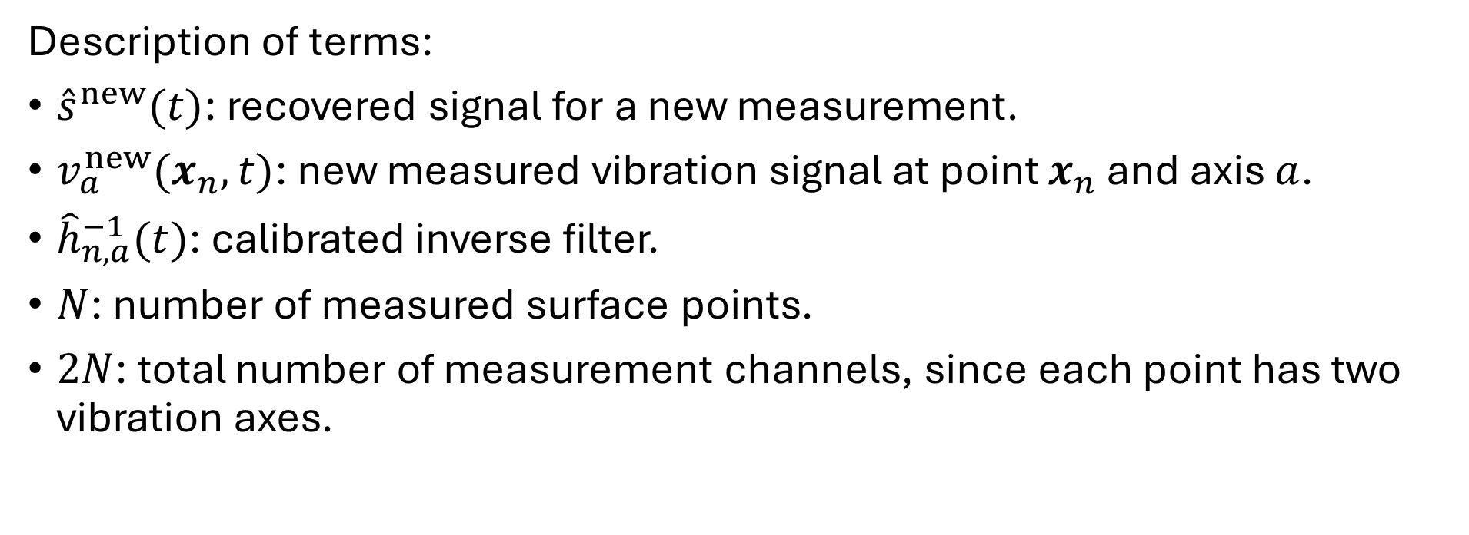

Recovered signal using calibrated inverse filters
$${\hat{s}}^{new}(t)=\frac{1}{2N}\sum_{a=1}^{2}{\sum_{n=1}^{N}{v_{a}^{new}}}(x_{n},t)∗{\hat{h}}_{n,a}^{−1}(t)$$
Description of terms:
${\hat{s}}^{new}(t)$: recovered signal for a new measurement.
$v_{a}^{new}(x_{n},t)$: new measured vibration signal at point $x_{n}$ and axis $a$.
${\hat{h}}_{n,a}^{−1}(t)$: calibrated inverse filter.
$N$: number of measured surface points.
$2N$: total number of measurement channels, since each point has two vibration axes.

